Slide 1
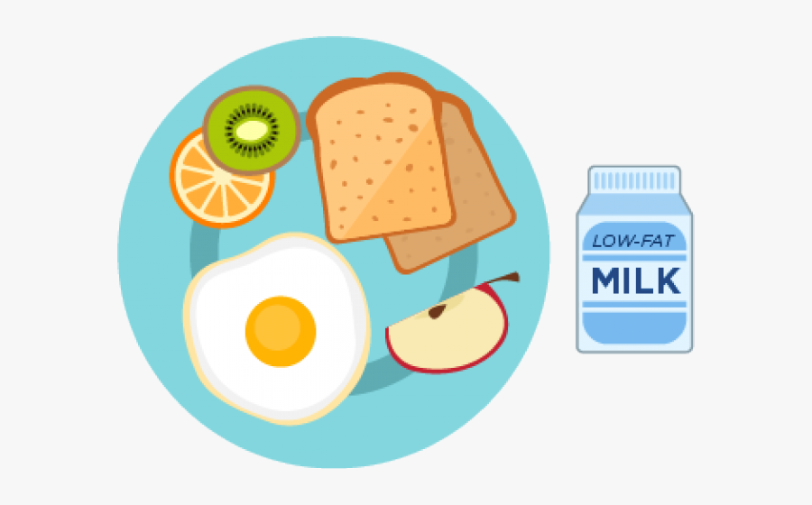

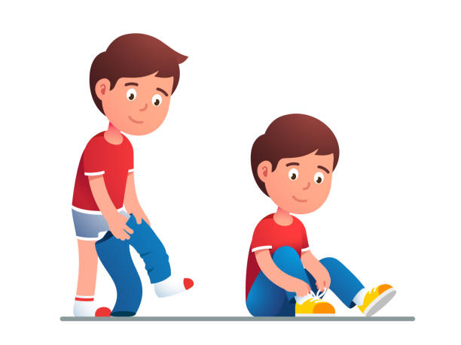
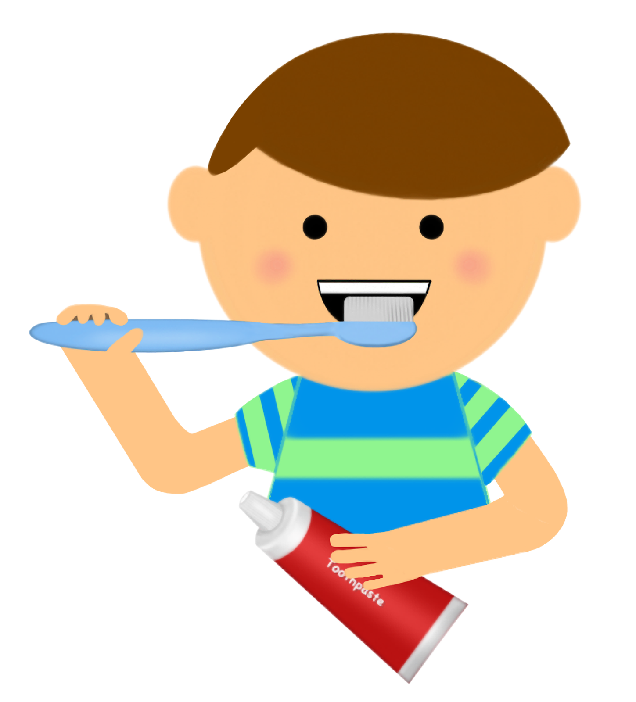
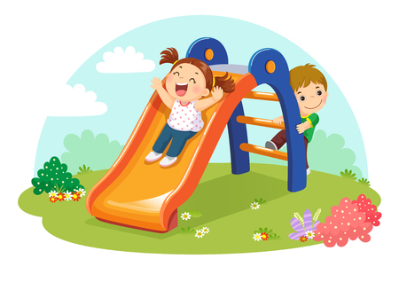
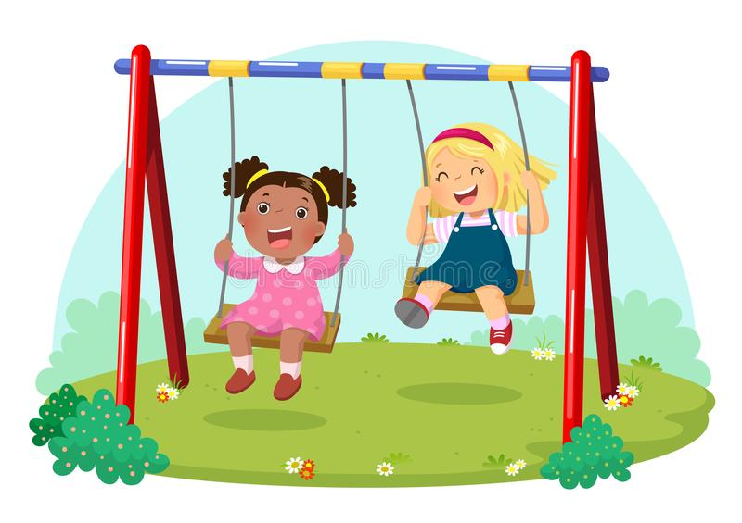



7:00-8:00
8:00-8:30
8:30-9:30
9:30-10:30
Breakfast
PBS Kids
Get dressed
Brush teeth
Outdoor
play
Read
Write
Cut

Slide 2
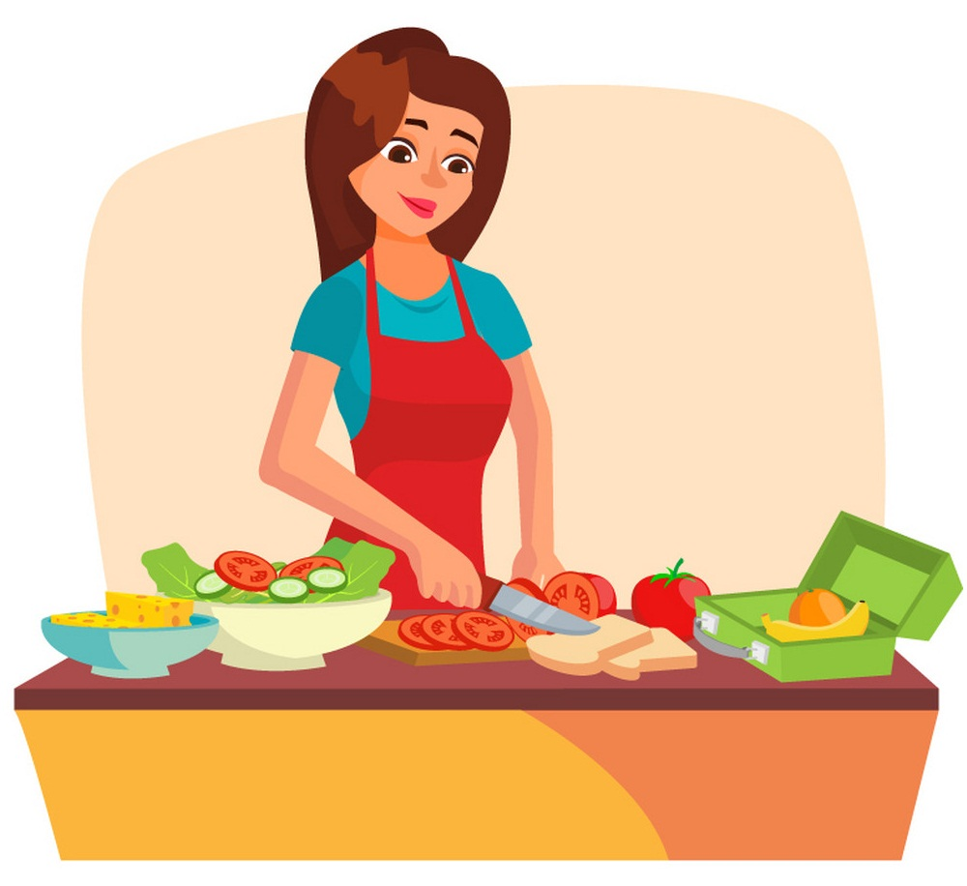
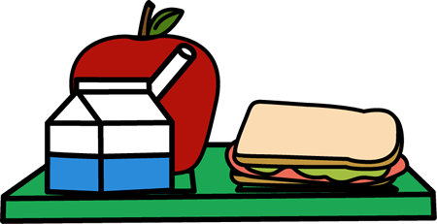
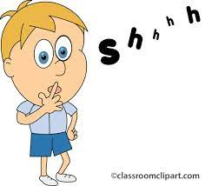
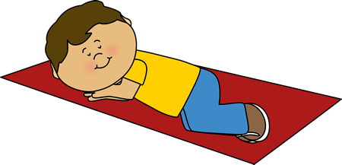
10:30-11:00
11:00-12:00
12:00-3:00
3:00-5:00
Make lunch
Eat lunch
Nap
Quiet play
Outdoor
play

